Slide 1

Solidarity Fund PL
Advancing freedom, shared prosperity and security

Slide 2

A state treasury foundation and an implementer of Polish development cooperation.
Supervised and controlled by the Minister of Foreign Affairs
Recognized under the Development Cooperation Act​
Obtained Pillar Assessment in 2023
Acts in accordance with the principle of International Solidarity
SOLIDARITY FUND PL
in the system of Polish development cooperation

Slide 3
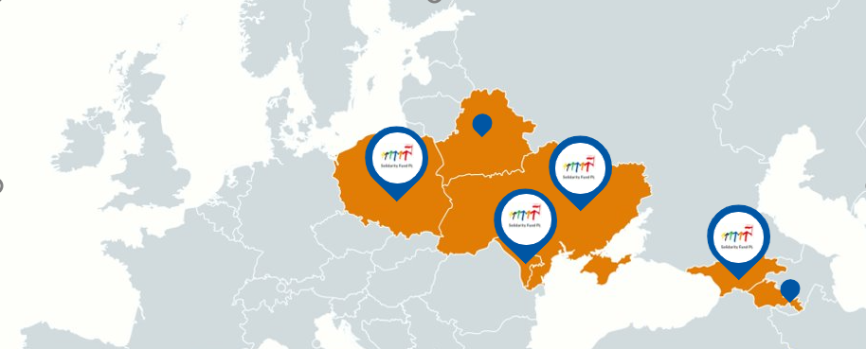

SFPL works in the EU Eastern Partnership countries: Ukraine, Moldova, Georgia, as well as in cooperation with the Belarusian civil society.
BRANCH OFFICES:
Kyiv
Chisinau
Tbilisi
BUDGET:
4 mln euro (2018)​
11,2 mln euro (2024)
ca. 20 mln euro (2025)​
TEAM:
104 FTE
Previously also in Central Asia, North Africa, the Middle East, and Russia

Slide 4

AREAS OF INTERVENTION
BELARUS
UKRAINE
MOLDOVA
GEORGIA
Human Rights and Democracy
Free Media and Information
Security and Civil Protection
Human Capital Development
Strong Institutions and Good Gov.
Local Development
Sustainable Energy

Slide 5
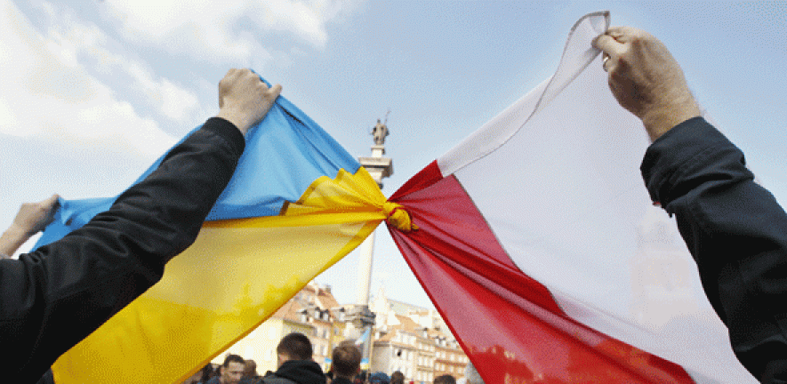
Ukraine
Psychosocial reintegration of people affected by war (services & retreats)
01
02
Vocational education and labour market
Self-governance and regional development
03
04
Civil protection
05
Support for EU integration

Slide 6


Georgia
DEVELOPMENT OF WELL-FUNCTIONING LOCAL INSTITUTIONS AND A RESILIENT CIVIL SOCIETY
01
Energy efficiency
02
Social development in rural areas through digital inclusion

Slide 7
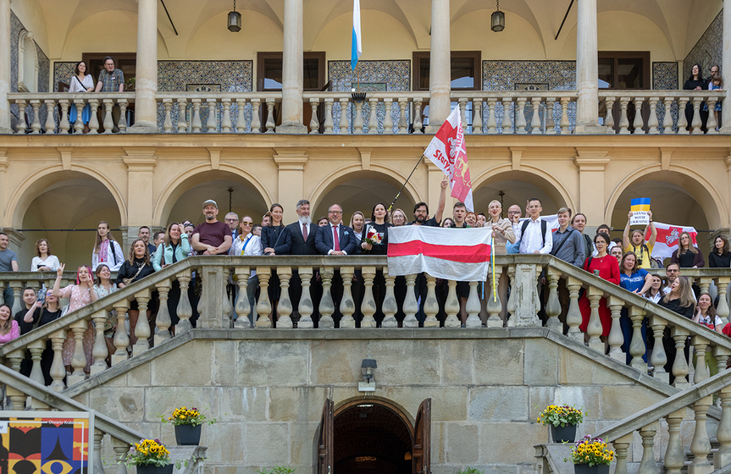
Belarus
HUMAN RIGHTS AND DEMOCRACY
Building the resilience of civil society, respect for human rights and ensuring access to reliable information
01

Slide 8
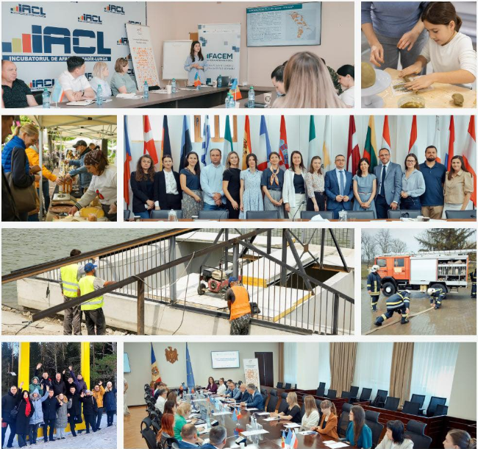
Moldova
SECURE STATE, RESILIENT COMMUNITIES AND SUSTAINABLE LOCAL DEVELOPMENT
01
Security and resilience
02
Self-governance and local development
03
Entrepreneurial development
04
Support for EU integration

Slide 9

THANK YOU! HAPPY TO ANSWER QUESTIONS
Tomasz Horbowski
e-mail: tomasz.horbowski@solidarityfund.pl

