Slide 1
Next MFF and Global Europe

Slide 2
An ambitious EU budget for an ambitious Europe
Commitment appropriations are based on adopted Multiannual Financial Frameworks (including European Union Solidarity Fund and European Aid Reserve.
Gross National Income amounts are based on the first Technical Adjustments of the respective Multiannual Financial Framework.

Slide 3
Proposed design for the next MFF
European Competitiveness Fund
(incl. Horizon Europe, Innovation Fund 41bn not included)
National and Regional Partnership Plans
Total
EUR 2 trillion
Erasmus+ & AgoraEU
  From 52 to 16 programmes
  Simpler for beneficiaries
  Results oriented
  More agile
Global Europe
Other (*)
(*) CEF, Civil protection and health, Single Market Programme, Euratom Research & Training, CFSP, Justice, INSC-D, DOAG, Pericles.
Excludes NextGenerationEU repayment
All amounts in EUR, current prices

Slide 4
MFF Headings
A 7-year MFF: 2028-2034
From 7 to 4 headings
1. EUROPE’S SOCIAL MODEL AND QUALITY OF LIFE
2. COMPETITIVENESS, PROSPERITY AND SECURITY
National and regional partnership plans
Repayment of NextGenerationEU
European Competitiveness Fund including Horizon Europe
Erasmus+; AgoraEU; Justice; Union Civil Protection Mechanism & Health Response
Connecting Europe Facility; Single Market Programme; Euratom/ITER; Nuclear decommissioning; Pericles
3. GLOBAL EUROPE
Global Europe
Common Foreign and Security Policy, Overseas countries and Territories, Sustainable fisheries partnership agreements and Regional fisheries management organisations
4. ADMINISTRATION

Slide 5
Global Europe - Guiding principles
Simplification
One main instrument for EU external action financing
Flexibility and predictability
Emerging challenges and priorities cushion
Impact
Toolbox to build comprehensive partnerships
Horizontal Performance Regulation
Coherence
Further geographisation
Coherence internal – external policies/programmes
Team Europe approach
Streamlined guarantee and blending framework
Complementarity within the Instrument
Targets: ODA, climate and environment
Financial flexibilities
Ukraine funding from the MFF headroom and implemented through Global Europe
Humanitarian aid funded under Global Europe
Stronger promotion of European interests

Slide 6
Simplification
NDICI-Global Europe
Ukraine Facility
IPA III
DOAG
INSC-D (merged and moved to heading 2)
Moldova Facility
Western Balkans Facility
Performance Regulation
Funding for Humanitarian aid
CFSP
EPF (outside the EU budget)
SFPA and RFMO
Global Europe
Notes:
CFSP = Common Foreign and Security Policy
DOAG = Decision on the Overseas Association, including Greenland
EPF = European Peace Facility
INSC-D = Instrument for International Nuclear Safety Cooperation – Decommissioning
IPA III = Instrument for pre-accession assistance
SFPA = Sustainable Fisheries Partnership Agreements
RFMO = Regional Fisheries Management Organisations

Slide 7
Simplification
Global Europe is the main external instrument, complemented by DOAG, INSC-D and CFSP, as well as EPF (outside the EU budget)
Global Europe supports the specificities of each policy, while increasing coherence and effectiveness of EU external action financing. The main policies served by Global Europe are:
  Enlargement
  Neighbourhood
  International partnerships
  Humanitarian aid
Reconstruction and pre-accession assistance for Ukraine are proposed to be financed over and above the MFF ceilings (the so-called ‘headroom’ of the MFF) and implemented through Global Europe
Humanitarian aid actions are proposed to be funded under Global Europe and implemented through the Humanitarian Aid Regulation
Notes:
CFSP = Common Foreign and Security Policy
DOAG = Decision on the Overseas Association, including Greenland
EPF = European Peace Facility (outside the EU budget)
INSC = Instrument for International Nuclear Safety Cooperation

Slide 8
Simplification - Performance Regulation
    Consistent provisions for supporting horizontal principles across the EU budget
    Streamlining and harmonising the system for monitoring EU spending and the performance of the budget
    Harmonising and rationalising the reporting of performance information and the provision of information about funding opportunities
    Common rules on other topics, such as the evaluation of programmes and activities, as well as rules on information, communication and visibility

Slide 9
Coherence – Further geographisation
Europe
Middle-East, North Africa and the Gulf
Sub-Saharan Africa
Asia and the Pacific
The Americas and the Caribbean
Global
Programmable actions
Non-programmable actions
Humanitarian aid
Resilience
Crisis, peace and foreign policy needs
Competitiveness
Programmable actions (under each pillar)
Non programmable actions (under each pillar)
            Humanitarian aid
            Macro-financial assistance
            Resilience
            Competitiveness
            Crisis, peace and foreign policy needs
Emerging challenges and priorities cushion

Slide 10
Coherence
Complementarity within Global Europe: implemented primarily through geographic programmable actions, complemented by non-programmable and global actions. Global pillar to focus on truly global actions
Increased coherence between internal and external programmes/policies, notably on:
    Migration
    EU competitiveness, trade, investment, and economic cooperation
    Climate and environment
    Digital
    Erasmus+
Improved alignment of pre-accession assistance with internal programmes, through implementing rules to be specified at a later stage to ensure consistency with internal headings
The Team Europe approach is enshrined, with the inclusion of MS’ and EU’s development finance institutions and export credit agencies

Slide 11
Flexibility and predictability
Budgetary flexibilities:
    Emerging challenges and priorities cushion
    Carry-overs, surpluses and reflows can be reused in the Instrument.
    Decommitments will follow the general rules set in the MFF Regulation.
    Easier budgetary transfers between and within Global Europe pillars
  Global Europe ensures predictability for EU’s partners and supports the EU role as a global actor
  ODA target at 90%, modifiable through a delegated act, demonstrating the EU’s commitment to sustainable development
  Climate and environment spending target (30% of Global Europe)

Slide 12
Impact
Broad toolbox to build comprehensive packages, further supporting Global Gateway, including:
      Budgetary guarantee and blending
      Policy-based loans
      Direct awards to EU companies
      Macro-financial assistance
Streamlined guarantee and blending framework
      Level-playing field
      No separate objectives
      Global Europe Investment Board
Stronger promotion of European interests
      Revised eligibility rules (restriction possible for EU’s strategic interests in direct and indirect management)
      European preference extended to all indirect management

Slide 13
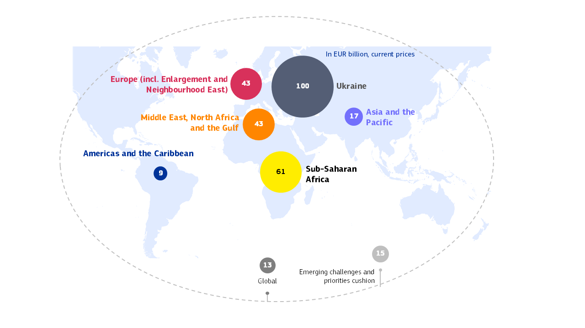
Financial framework
EUR 200 billion for Global Europe, including EUR 25 billion for HUMA
EUR 100 billion Ukraine Reserve

Slide 14
Financial framework – Ukraine reserve
Maximum amount made available to Ukraine, in the form of loans and/or other financial resources (incl. non-repayable support, financial instruments, provisioning of budgetary guarantee) set at EUR 100 billion.
    Up to EUR 100 billion of financial resources sourced from the Ukraine Reserve over and above the MFF ceilings and mobilised through the annual budget procedure.
    Loans to Ukraine backed by the headroom (no provisioning rate) for up to EUR 100 billion.
Support to Ukraine in the form of a budgetary guarantee up to EUR 48 billion (provisioned from the Ukraine Reserve at a rate initially set at 70%)
Financial resources of the Ukraine Reserve to be used to provide support to Ukraine under INSC-D.

Slide 15
Structure of Global Europe
TITLE I: General Provisions (Article 1 - 12)
Definitions, scope and structure, objectives, coherence, budget, general principles
TITLE II: Implementation of the instrument
Chapter I: General programming provisions (Article 13 - 17) on multiannual programming, principles for geographic programmes, the content of programming documents, and the procedure for adopting them
Chapter II: Action plans, measures and implementation principles (Article18 - 22) on action plans and measures which can be adopted, and the respective procedures, eligibility rules and flexibilities.
Chapter III: Implementation toolbox (Article 23 - 28) on available tools to deliver against the objectives of the Instrument, notably budgetary guarantees, blending and financial assistance.
TITLE III: Final Provisions (Article 29 - 35)
Delegation of powers, committee procedure, transitional provisions, EEAS clause, and entry into force
Implementing rules for the Europe pillar: common rules for pre-accession assistance and facility-type performance-based plans

Slide 16
Title I - General Provisions – Objectives and principles
GENERAL OBJECTIVES – Article 4
GENERAL PRINCIPLES – Article 9
Uphold and promote the Union’s values and interests worldwide, to pursue objectives and principles of the Union’s external action (Art 3(5), 8 and 21 TEU)
Contribute to the promotion of multilateralism and a rules-based international order
Promote stronger mutually beneficial partnerships with partner countries
Achievement of the international commitments and objectives, as the SDGs
Concentrate means where they can make the most transformational impact
Engage in contexts experiencing extremely high levels of fragility, conflict areas, and other complex settings
Promote, develop and consolidate the principles of democracy, good governance, the rule of law and respect for human rights and fundamental freedoms
Apply a human rights-based approach guided by the principles of ‘leaving no one behind’, equality, non-discrimination on any grounds
Promote gender equality and girls’ and women’s empowerment and prevent and fight violence against women and domestic violence
Base cooperation on development effectiveness principles, and promote multilateralism
Ensure that relevant stakeholders of partner countries, including civil society organisations and local authorities, are duly consulted and have timely access to relevant information
Notes:
TEU :
Art 3(5): In its relations with the wider world, the Union shall uphold and promote its values and interests and contribute to the protection of its citizens. It shall contribute to peace, security, the sustainable development of the Earth, solidarity and mutual respect among peoples, free and fair trade, eradication of poverty and the protection of human rights, in particular the rights of the child, as well as to the strict observance and the development of international law, including respect for the principles of the United Nations Charter
Art 8 :
1. The Union shall develop a special relationship with neighbouring countries, aiming to establish an area of prosperity and good neighbourliness, founded on the values of the Union and characterised by close and peaceful relations based on cooperation. […]
Art 21:
1. The Union's action on the international scene shall be guided by the principles which have inspired its own creation, development and enlargement, and which it seeks to advance in the wider world: democracy, the rule of law, the universality and indivisibility of human rights and fundamental freedoms, respect for human dignity, the principles of equality and solidarity, and respect for the principles of the United Nations Charter and international law. The Union shall seek to develop relations and build partnerships with third countries, and international, regional or global organisations which share the principles referred to in the first subparagraph. It shall promote multilateral solutions to common problems, in particular in the framework of the United Nations. […]

Slide 17
Title I - General Provisions
Article 10 – Mainstreaming
Fight against climate change and environmental protection
Gender Equality
Article 11 – Team Europe approach
Close coordination to improve coherence and complementarity
Timely consultations and exchange of information
Joint identification, design and implementation of actions
Cooperation with like-minded partners and stakeholders
Article 12 – Migration and forced displacement
Comprehensive approach, with a focus on countries of origin, transit and departure in a whole-of-route approach
Leverage through a flexible approach, which allows to adjust the volume of funds to be allocated, and to suspend payments or the implementation of a programme, in case of serious shortcomings related to the readmission, taking into account the overall relation with the country concerned.

Slide 18
Title II – Chapter I - Programming provisions
General programming approach (Article 13)
Programming documents shall provide a coherent framework for cooperation between the Union, partner countries or regions and other partners.
The Commission shall consult other donors and actors, including local authorities, CSOs and the private sector, and shall inform the European Parliament and the Council about the outcome of the consultations.
Geographic programming principles (Article 14)
Based on dialogue between the Union, Member States and partner countries concerned, including local authorities and involving CSOs
Shall provide a specific, tailor-made framework for cooperation, and may envisage activities funded from different pillars
Geographic programming documents (Article 15) | Global programming documents (Article 16)
Multiannual country, multi-country, regional or trans-regional indicative programmes Shall set out : priority areas, specific objectives and, where appropriate, the indicative financial allocations and the methods of implementation Shall be based on: national/regional strategies, performance-based plans, or other joint and framework documents, as relevant | Multiannual indicative programmes Shall set out: Union’s strategy, priorities, specific objectives and the indicative financial allocations

Slide 19
Title II – Chapter II - Action plans, measures and implementation principles (1)
Article 18 – Action Plans and Measures
  Commission adopts annual/multiannual action plans and measures, specifying objectives, expected results, activities, budget, and implementation methods.
  Actions and individual measures funded by programmable amounts shall be based on programming documents.
  Special measures can be adopted in response to unforeseen circumstances.
  Exceptional assistance measures can be adopted for crises, peace and foreign policy needs, for up to 18 months (with possibility to extend up to 30 months).
Article 19 – Adoption of action plans and measures
  Action plans and measures shall be adopted through implementing acts, following the Committee procedure (Art 32.2) with some exceptions, including:
Action plans and individual measures up to EUR 10 M | Special and support measures up to EUR 20 M | Action plans for crisis, peace and foreign policy needs, and exceptional assistance measures up to EUR 40 M
Ex-post information of the European Parliament and Member States through the Global Europe committee |  | Information of the European Parliament and the Council before the adoption, or ex post information of the European Parliament and Member States through the Global Europe committee

Slide 20
Title II – Chapter II - Action plans, measures and implementation principles (2)
Article 20 – Eligibility rules of NDICI-GE and IPA III generally maintained as default option, but possibility to restrict on a case by case on the basis of EU strategic interests (for both direct and indirect management)
Article 21 – Excluded Activities
  No funding for actions violating human rights in partner countries.
  DNSH covered by the horizontal performance regulation
Article 22 – Carry-overs, annual instalments, re-payments, revenue and recoveries from financial instruments and surpluses from the budgetary guarantee
  Automatic carry over of appropriations to year N+1, as under NDICI-GE.
  Provisioning surpluses and reflows from financial instruments remain in the Instrument. Reflows/surpluses from legacy instruments can also be re-used.
  Decommitments will follow the general rules set in the MFF Regulation.

Slide 21
Title II – Chapter III – Implementation toolbox (1)
Article 23 – Implementation and forms of Union funding
  Direct and indirect management.
  Full financial regulation toolbox, including grants (incl. civil society support), procurement, budget support, loans, budgetary guarantees, financial instruments, blending, and trust funds.
  Direct grants (without calls) are allowed e.g., in urgent or high-risk contexts or to companies from Member States if in the strategic interest of the EU.
  European preference for implementing partners in indirect management.
Article 24-25 – Budgetary guarantees and financial assistance
  Maximum amount of EUR 95 billion of budgetary guarantee, financial assistance (MFA and policy-based loans) and Euratom loans – excluding Ukraine.
  Provisioning rates like under NDICI-GE: between 9% and 50% depending on the operations; 9% for sovereign risks.
  Provisioning rates to be reviewed every year and in line with the risk management framework.
  Full open architecture model.
  Global Europe Investment Board to provide strategic and operational guidance to the Commission.

Slide 22
Title II – Chapter III – Implementation toolbox (2)
Article 26 – Implementation of policy-based loans
  Commission implementing decision to make loans available to partner countries, subject to comitology.
  Loan agreements specify amount, timing, conditions, and possible pre-financing.
Article 27 – Capital participation in development finance institutions
  Possibility to finance capital endowment of European and other development finance institutions
Article 28 – Cross-Border Cooperation
  Support cooperation across external borders.
  Europe and Middle East, North Africa and the Gulf pillars may contribute to cross-border cooperation co-financed by National and Regional Partnerships Regulation
  Allocation of up to 3% of Europe pillar envelope to it.

Slide 23
Title III – Final provisions
Article 30 – Exercise of delegation
  Power to adopt delegated acts to amend:
    Article 6(5): ODA target
    Article 24(1): maximum amount of the budget guarantee
    Article 24(2): provisioning rates
    Article 24(3): maximum amount of the budgetary guarantee, and provisioning rate for Ukraine
    Annex II : Specific objectives
Article 31 – Adoption of further implementing rules for the Europe pillar
  Implementing act to establishing uniform conditions for implementing the instrument in Enlargement and Neighbourhood East countries, in relation to :
    Design and content of the performance-based plans
    Performance, structure and control systems in preparation of the accession
    Management of structural, agricultural and cross-border cooperation funds

