Slide 1

INEQUALITY MARKER
By Mathilde Cournut, Policy Officer, European Commission- Directorate General for International Partnerships, Unit G4 (Health Social Protection, Inequality Reduction)
23/09/25, 16:30-17:30, Practitioners’ Network

Slide 2
HOW AND WHEN WAS THE I-MARKER DEVELOPED?
3 July 2024
Launch of the first results of the Inequality Marker
2025
2024
The Commission Staff Working Document ‘Implementation of the new European Consensus on Development – Addressing inequality in partner countries’, and the following Council’s Conclusions
INTPA Reference Document “Addressing income inequalities through development cooperation”
Inequality Marker Guidelines, together with a One-Pager, a Video and an E-Learning
5 June 2025
Integration of I-Marker into the European Fund for Sustainable Development Plus (EFSD+), with specific guidelines and one-pager
26 May 2025
Release of the 2024 I-Marker results at the launch of the Equality Flagship, “Inclusive Societies in Latin America and the Caribbean” programme
2023
2019
2021
2022
June 2023
Official and public launch of the I-Marker to external stakeholders
November 2023
Council Conclusions (21/11), where “the Council recommends the broadest application of the Inequality Marker”

Slide 3
WHAT THE I-MARKER DOES
(AND DOES NOT)?
Does not…
Measure changes in inequalities within countries.
Does… (SDG10)
Assesses whether, and to what extent, inequality reduction is an objective of a donor’s intervention and, therefore designed to benefit, to a larger extent, the bottom (poorest) 40 per cent or other socio-economically disadvantaged individuals, households, or groups.

Slide 4
WHAT IS THE INEQUALITY MARKER ?
The Inequality Marker is a strategic tool that allows DG INTPA to better understand, track, and benchmark how its actions contribute to reducing inequalities across all sectors, including Global Gateway priorities. It complements the gender and disability markers and reinforces our commitment to a 360° approach to Global Gateway.
(Policy tool) improves the design of interventions, to ensure that they have inequality-reducing effects.
(Advocacy tool) creates a sound reporting and benchmarking system, enabling to clearly establish the contribution of all relevant interventions to reducing inequality (also in its multidimensionality**). This is important for policy dialogue and communication.

Slide 5
HOW DOES IT WORK ?
I-0: If inequality reduction is not targeted
I- 1: If inequality reduction is a significant objective
I- 2: If inequality reduction is the principal objective

Slide 6
CRITERIA TO « I-MARKER »
Analysis of trends and drivers of inequalities in the policy area of the intervention
Objectives and activities of the intervention are designed to directly benefit the bottom (poorest) 40 per cent or other socio-economically disadvantaged individuals/groups
Measurable and relevant indicators are in place (with baselines and targets) to assess progress in delivering the expected benefits to the bottom (poorest) 40 per cent
Specific evaluation plan (or component in the foreseen evaluation) to assess the impact on the bottom (poorest) 40 per cent, including by using the Distributional Impact Assessment (DIA) methodology

Slide 7
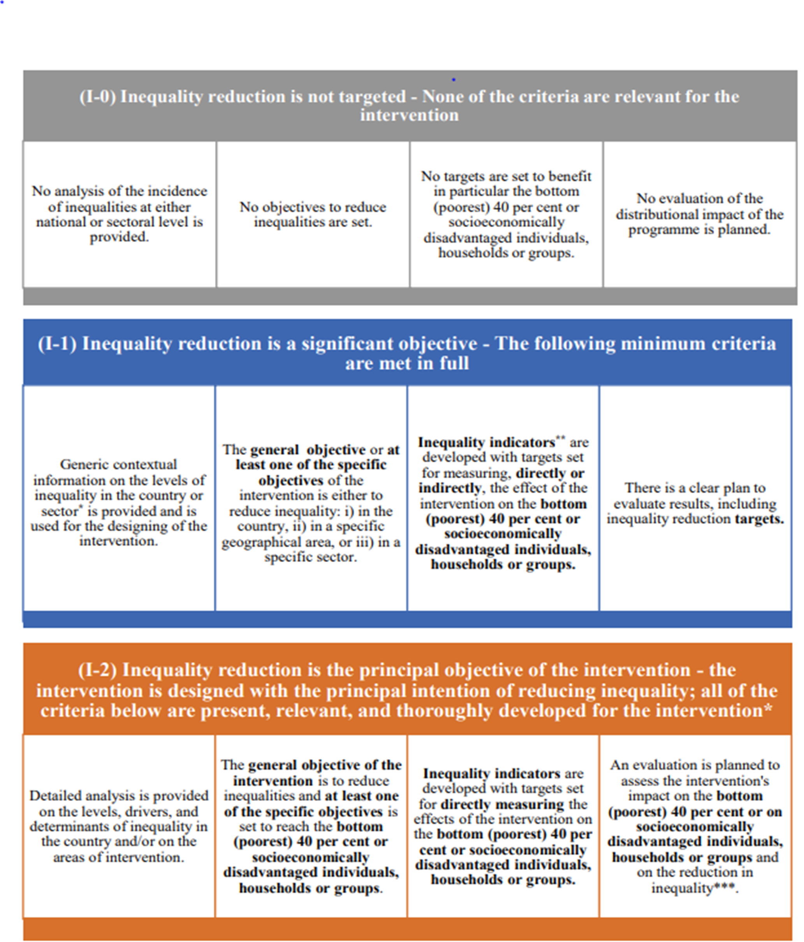
THE INEQUALITY
MARKER IN-DEPTH

Slide 8
Two illustrative Equality Flagships
The “Inclusive Societies in Latin America and the Caribbean” programme.
It fully meets the four I-2 criteria:
It includes a detailed diagnostic—analysing levels, drivers and structural determinants of inequalities.
Its overall objective is to tackle gender and other inequalities, reduce poverty and social exclusion, and strengthen social cohesion within and between LAC countries. It places a strong emphasis on the bottom 40%, as well as women, children, and youth.
It includes clear impact-level indicators, such as the income share of the bottom 40%.
It foresees a distributional impact assessment to evaluate whether the most vulnerable have directly benefited from the intervention.
The “Water and Sanitation” programme in Peru.
It meets all four I-1 criteria (sill under finalization by the EUD):
It provides contextual information on inequality, including disparities in access to water and sanitation services across different areas;
While reducing inequality is not the main objective, the action includes two specific objectives that significantly contribute to it: support wastewater reuse in drought-prone areas, and improved health-sector waste management in underserved urban areas, both directly benefiting vulnerable populations.
It includes indicators to track progress at outcome levels.
It also foresees an evaluation plan to assess the impact on the most vulnerable, ensuring that outcomes are monitored with a focus on inclusion.

Slide 9
2024 Inequality Marker Results
In 2024, 62% of new DG INTPA actions had inequality reduction either as a significant (I-1) or main objective (I-2), up from 59% in 2023. Specifically:
  8% of our actions were classified as I-2, meaning that reducing inequalities was a main objective,
  54% were marked as I-1, where it was a significant objective;
  38% did not target inequality reduction.
These results also demonstrate strong progress across all regions, with improvements in Asia-Pacific (from 59% to 61%) and in multi-country and global programmes (from 19% to 49%), as well as sustained high integration in Sub-Saharan Africa (76%) and Latin America (62%).

Slide 10
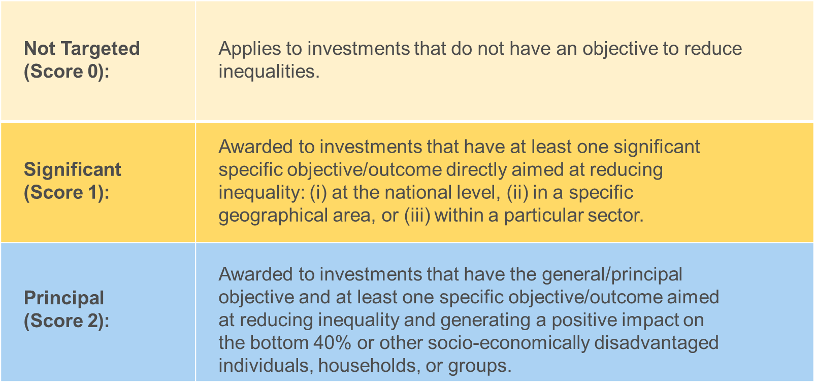
Application of the Inequality Marker to EFSD+
Officially launched on 5th June during the EFSD+ Blending Board to DFIs and Member States, the application of the I-Marker to EFSD+ will start with blending operations and will be extended to guarantees for the next call for proposals.
    For more information, the I-Marker guidelines to EFSD+ are available at: European Commission inequality marker - Publications Office of the EU and its one-pager.

Slide 11
RESOURCES
The I-Marker Guidelines: Inequality Marker Guidelines
The I-Marker One Pager: I-Marker one-pager.
The I-Marker Video: https://youtu.be/OgprsHYPrDsI
The I-Marker E-Learning : E-Learning on the Inequality Marker
Tools and Methods Series, Reference Document N°29 : Addressing income inequalities through development cooperation (EN/FR)
Volume 1, Concepts and definitions; Volume 2, Policy briefs to tackle inequalities; Volume 3, Guidelines for mainstreaming the reduction of inequality in interventions
Guidance for applying the inequality marker to the European Fund for Sustainable Development Plus: EFSD+ Guidelines and its one-pager
Capacity4Dev Groups: Fighting Inequalities through development cooperation and stronger partnerships

Slide 12
THANK YOU!

