Slide 1
OPSYS
OPSYS presentation to the
Implementing Partners & Contractors of External Actions
Key concepts
DEVCO.R.4. – Information Technology & Business Processes
October 15th, 2020

Slide 2
I. INTRODUCTION

Slide 3
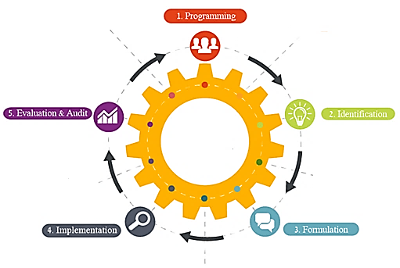
OPSYS Vision
OPSYS is a large-scale business transformation programme for the Relex family: “more efficient, transparent and results-oriented planning, management, and follow-up of EU external actions”
Business side: Relex family (DG DEVCO, DG NEAR, FPI)
IT side: DIGIT, RTD (plus BUDG, JRC)
Coverage: the entire programme-project cycle
OPSYS
OPSYS will interface with:
ABAC (Accrual-based Accounting System)
ARES (Advanced Records System)
EAMR (External Assistance Management Report)
OPSYS will integrate:
CRIS (Common External Relations Information System)
ROM (Results Oriented Monitoring Module)
EVAL (Evaluation Module)
E-Procurement
PROSPECT (application submission)
PADOR (organisation registration)
Audit
Grant Management
GIS

Slide 4
OPSYS as in "EU for Results"
Opsys as a tool for "EU Budget & Policies Performance Monitoring and follow up "
  better spending
  increased accountability and transparency
  maximum added value for EU citizens
Results framework through the cycle of operations
  Result and performance Indicators (logframe result chain)
  Sectors & cross-cutting allocations
  Policy markers
  Geographical location
Internal "performance management"
  Collect and monitor relevant key performance indicators (KPIs)

Slide 5
FROM CRIS TO OPSYS MODEL
OPSYS
Basic act
CRIS
Domain
Basic act component
Programming
Programming component
Programming
Programming component sector
Programming focal/non focal sector
CFD
MAP CL1
Decision
Logframe
CL1
FA
Action
Measure project
Intervention
Action component
Analytical breakdown
Individual contracts
Implementation plan
Planned contract
Contract

Slide 6
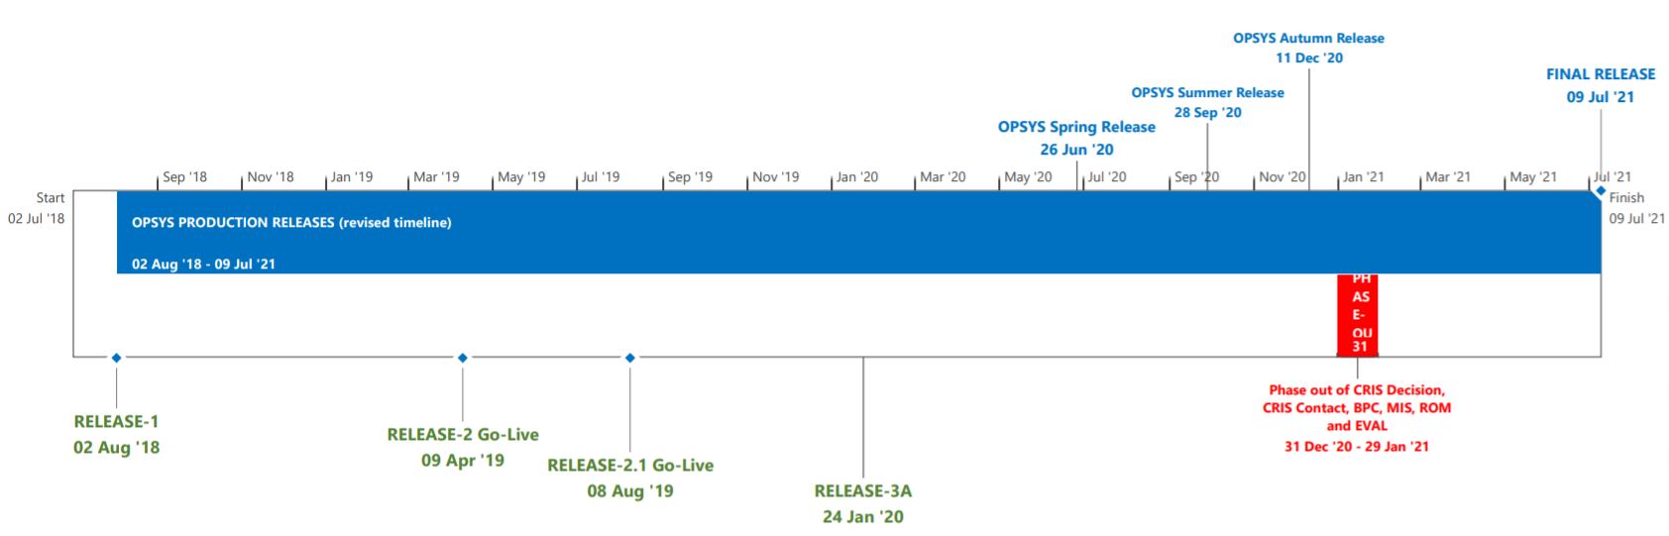
Global Planning
OPSYS
State of Play
Priorities
CM Solutions

Slide 7
Autumn Release
Intended Go Live: December 2020
Scope
    Action Management (incl. the design of Actions, pipeline management, contract planning, CFD, CL1 management and amendments, etc.) to be ready for the new MFF.
    Close follow-up is required, in particular to analyze risk mitigation measures
State of Play
Priorities
CM Solutions

Slide 8
Results Reporting Release
Intended Go Live: October 2020
Scope
  Results Reporting features for Operational Managers
  Results Reporting features for Quality Managers
  Versioning of Logframes
  Results Reporting campaign for 2020 in OPSYS:
    - Pilot to be conducted end of October with several Units and EUDs of RELEX family
State of Play
Priorities
CM Solutions

Slide 9
Summer Release
Intended Go Live: September 2020
Scope
Track 2
    Covering Contract Management (Version 5.0) > All contractual procedures
    Finalised minimum viable product in Q1 - 2021 only
    Impacts on Contract Migration > full Wave 1 (Q1-2021) and full Wave 2 (Q2-2021)
Track 3
    Management of Basic Act and Programming
    Available for the users only after the conclusion of the business validation process
State of Play
Priorities
CM Solutions

Slide 10
OPSYS State of Play
Good performance of Public Procurement Management Tool (PPMT) which went live in DEVCO, NEAR and FPI in August 2020. From August to end of October, the main training goal to meet the needs of users who had to launch a CfT within short notice. As of November, the training offer will enter a cruising pace.
PRAG templates & guidelines have been updated along OPSYS developments: transition from paper templates to new Electronic Contract.
Around 1,300 PICs (Participant Identification Codes) have been created in the Funding & Tenders Portal.
Phasing out of EuropeAid, the Calls for Proposals and Tenders portal.
Migration of CRIS Contracts to OPSYS
State of Play
Priorities
CM Solutions

Slide 11
II. OPSYS TODAY

Slide 12
OPSYS Today for «Internal» users:
Logframe Management –> LFs + Indicators
Management of contracts under FWCs SIEA2018, AUDIT2018 PSF2019 (for FPI), EVA2020 & EVENTS2020
OPSYS Today for «External» users:
Access to OPSYS –> Registration
Logframe Data Entry –> LFs + Indicators

Slide 13
HOW ARE EXTERNALS COLLABORATING WITH OM FOR NOW?
for modules available in OPSYS today
in LOGFRAMES (INTERVENTIONS)
(core tool of the PPCM methodology)
NO NEED FOR A PIC!!!
The Operational Manager grants access
to the Lead Implementing Partner (LIP)
simply by identifying its email address
notification is sent to the LIP
via the F&T portal + email
for Framework Contracts
Examples: SIEA2018, AUDIT2018 & PSF2019 (FPI)
PIC NEEDED!!!
Framework Contractors have registered their profiles in F&T Portal.
They have obtained an official PIC
and identified a PCoCo.
* OM: Operational Manager

Slide 14
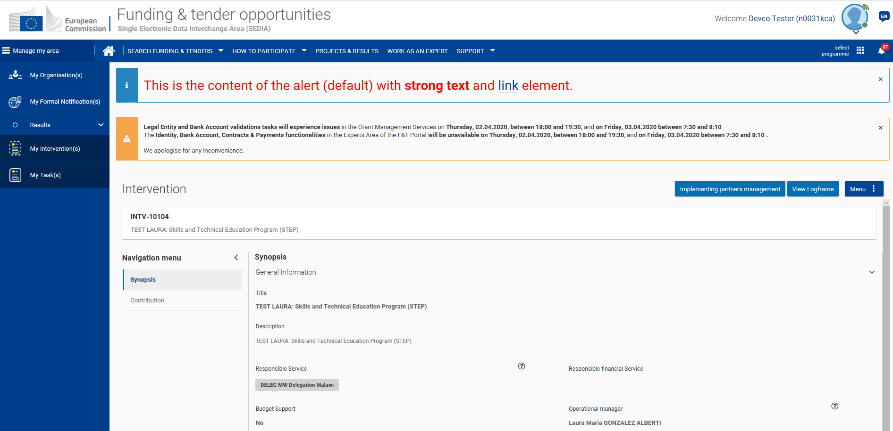
F&T Portal : one single entry point for externals

Slide 15
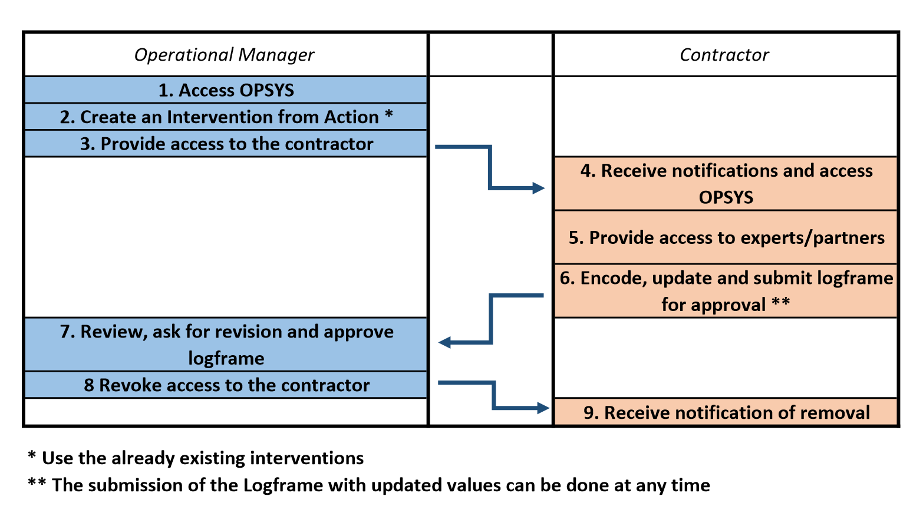
OPSYS LOGFRAME MANAGEMENT Workflow

Slide 16
IV. OPSYS TOMORROW
New for Contractors!
(not new for Framework Contractors)

Slide 17
OPSYS List of contracting procedures
Family 1: Contribution Agr. & Direct award grant Grants
Family 4: Proc. IM with PC with publication
Family 7 : DM Grants with publication
A. Direct Award with electronic signature - Contribution Agreements
Contribution agreement
Contribution agreement with blending
Contribution agreement (CFSP / EUSR) TBC
D. Indirect Management with PC - 1 stage
1. International Open - Services in IM
2. International Open - Supplies in IM
3. International Open - Works in IM
4. Local open - Supplies in IM
5. Local Open - Works in IM
J. Open CfP
1. Grant through Open CfP
2. Twinning
3. Twinning Light
B. Direct Award with electronic signature - Grants
1. Direct award of Low value Grant
2. Direct award of grant
3. Direct award of a Specific Grant under a FPA
K. Restricted CfP
1. Grant through Restricted CfP
D. Indirect Management with PC - 2 stages 1. International Restricted - Services in IM
2. International Restricted - Supplies in IM
3. International Restricted - Works in IM
Family 8: CL2 following a FA
G. CL2 following FA
1. Budget support
2. Pre-accession - Financing Memorandum (I.M.B.C.)
3. Pool fund
4. PEGASE
Family 2: Programme Estimates & WB CA
C. Direct Award without electronic signature
1. Administration agreement (with World Bank)
2. Programme Estimate – Central operation
3. Programme Estimate – Public body
4. Programme Estimate – Private body
5. Direct Award of Grant without electronic signature
6. Contribution agreement (CFSP / EUSR) in case not in family "A"?
  Family 5 : IM with PC without publication
E. Indirect Management with PC
(Procurement and Grants without publication)
1. Single tender – Services in IM
2. Single tender – Supplies in IM
3. Single tender – Works in IM
4. Negotiated – Services in IM
5. Negotiated – Supplies in IM
6. Negotiated – Works in IM
7. Simplified – Service in IM
8. Simplified – Supplies in IM
9. Simplified – Works in IM
10. Direct Award of Grant in IM
Family 9 : DM proc. Without publication
P. Simplified
1. Simplified Call for tender – Services
2. Simplified Call for tender – Supplies
3. Simplified Call for tender – Works
O. Negotiated
1. Single tender – Services
2. Single tender – Supplies
3. Single tender – Works
4. Negotiated procedure – Services
5. Negotiated procedure – Supplies
6. Negotiated procedure – Works
Family 3 : DM Procurement with publication
Q. Open
1. International Open – Services
2. International Open – Supplies
3. International Open – Works
4. Local Open – Supplies
5. Local Open – Works
Family 6 : Grants IM with PC with publication
F. Indirect Management with PC (Grants)
1. Grants through Open CfP in IM
2. Twinning in IM
3. Twinning Light in IM
4. Grants through Restricted CfP in IM
Family 10 : Other SCs RELEX
R. Restricted
1. Intal Restricted tender – Services
2. Intal Restricted tender – Supplies
3. Intal Restricted tender – Works
M. SCs under other External action FWCs
1. EVENTS 2020
2. EVAL 2020
3. EOM 2020

Slide 18
Procedures in coming Releases
 | electronic pre-award
electronic signature | No | limited to publication | Yes
Yes | Contribution agreements Direct award of grants |  | Grants in DM
 |  |  | other SC Relex
 |  |  | Procurement DM in 5A version: Simplified/negotiated
 |  |  | Procurement DM in 5A version: Open, restricted
No | Programme Estimates WB Admin. Agreements | Procurement IM with publication: Restricted/Open
 | CL2 following FA (Budget Support..)
 | IM without publication: simplified/ negotiated, direct award of grants | Grants IM with publication

Slide 19
Procedures in coming Releases
 | electronic pre-award
electronic signature | No | limited to publication | Yes
Yes | Contribution agreements Direct award of grants |  | Grants in DM
 |  |  | other SC Relex
 |  |  | Procurement DM in 5A version: Simplified/negotiated
 |  |  | Procurement DM in 5A version: Open, restricted
No | Programme Estimates WB Admin. Agreements | Procurement IM with publication: Restricted/Open
 | CL2 following FA (Budget Support..)
 | IM without publication: simplified/ negotiated, direct award of grants | Grants IM with publication

Slide 20
Direct Award with e-signature
Contribution Agreement
Direct award of grants
Planned contract
No publication
Pre-award (on paper)
Contract preparation
Budgetary Commitment and Visa chain
E-signature
Management of Deliverables
Management of Amendments
    Amendments initiated by Contracting Partner
    Amendments initiated by EU
  Closing of contract

Slide 21




Normal track with electronic signature
Contribution Agreement
Direct award of grants
Upload documents
CONTRACT PREPARATION AND SIGNATURE
Contracting authority
OIA/FIA
OIA/FIA
OVA
FVA
AO
OIA/FIA
LSIGN
Prepare the draft contract
Review the draft contract
Visa chain
Send contract
Sign contract
Draft contract + annexes
Validated contract
Contract signed by contracting partner
AO
AO
Sign the contract
Commit funds in ABAC
Contract signed by both parties

Slide 22

Deliverables
Contribution Agreement
Direct award of grants
Report
Comments
MANAGE DELIVERABLES
Contracting Authority
OIA
OIA
CoCo
OIA
Encode deliverable at contract prep.
Record effective start date
Update contractual deliverables
Upload contractual deliverable
Approve contractual deliverable
Document
MANAGE DELIVERABLES
Contracting Partner
CoCo
Upload ad-hoc deliverables

Slide 23

Amendments by Contracting Partner - e-sign
Contribution Agreement
Direct award of grants
Annexes
AMENDMENTS initiated by Contracting Partner
CoCo
CoCo
LSIGN
Prepare amendment
Generate automatic clauses
Select other clauses
Generate amendment
Signature
OIA/FIA
Draft Amendment
Amendment signed by Contracting Partner
Consultation (if requested)
OIA/FIA
OVA/FVA
AO
AMENDMENTS
Contracting Authority
AO
Authorise in ABAC (if needed)
Visa chain and signature
Amendment signed

Slide 24
Amendments by EU with e-sign
Contribution Agreement
Direct award of grants
Annexes
AMENDMENTS initiated by EU
Contracting Authority
OIA/FIA
OVA
FVA
AO
OIA/FIA
OIA/FIA
AO
Prepare amendment
Generate automatic clauses
Select other clauses
Generate amendment
Visa chain and signature
Authorise in ABAC (if needed)
Draft Amendment
Amendment signed by EU
AMENDMENTS
Contracting Partner
LSIGN
Sign Amendment
Amendment signed

Slide 25
VII. Documentation & Support

Slide 26
Useful links
wiki : https://webgate.ec.europa.eu/fpfis/wikis/display/ExactExternalWiki
specifically for Funding & Tender Opportunities Portal go to:
https://webgate.ec.europa.eu/fpfis/wikis/display/ExactExternalWiki/Funding+and+Tender+Opportunities+Portal
and for procurement to : https://webgate.ec.europa.eu/fpfis/wikis/display/ExactExternalWiki/Contracts+and+Procurements
In the e-learning section you can find all the modules & pills we have available for our external users
We have created an OPSYS page in DEVCO Academy to give access to our external users to out e-learning modules & Pills (information on the F&T Portal).
Other:
External action Landing page in the Funding & Tender Opportunities Portal:
https://ec.europa.eu/info/funding-tenders/opportunities/portal/screen/programmes/eu-external-actions
DEVCO website funding page: https://ec.europa.eu/international-partnerships/funding/looking-for-funding_en

Slide 27
For IT-related Support on F&TP
EC SEDIA SUPPORT (FMB)
Email address: ec-sedia-support@ec.europa.eu

Slide 28
Questions and Answers

Slide 29
When are going to take place the training sessions for external partners/implementing partners on the publication of tenders?
When are going to take place the OPSYS trainings for external partners?
When will reporting start in OPSYS?
When is it envisaged to start negotiating and signing contracts (Service Contracts or CA18) via OPSYS?
Is OPSYS an open source software?
External partners having their own information systems and having, additionally to report via OPSYS, what are the possibilities that information can be "introduced" one single time, allowing a "single source of truth" (SSOT) in the handling of both systems?
Some programmes such as EUROsociAL+ or EL PAcCTO have information management systems that allow the management and monitoring of projects, including technical and financial reporting, and monitoring of results. Will OPSYS integrate those system? If so, how?

Slide 30
Some projects in preparation have been told that they will be informed three months prior to the date of application of individual components of the system; will this be valid for all projects, also the ones already in implementation?
From the documents you shared in April about the Participant Identification Code (PIC) and OPSYS roles, we understand that that document identifies organisations participating in EU calls for tenders or calls for proposals. Does the PIC also apply for organisations mostly working in the delegated cooperation which does not foresees calls for proposals?
For the OPSYS part related to the logframes, and in order to start getting acquainted in both sides with this new system, would it be possible to have a list of OPSYS focal points from all EUDs and EC headquarters (for projects that are dealt from Brussels)? We consider that it would be easier for our project managers to get in contact with them.
Has the Tender and Funding Opportunities Portal already gone “live”? Is the LEAD of each organisation already linked to its organisation in the portal?
Apart from the OPSYS training for the PN, would it be possible to carry out (virtual) trainings in our headquarters (EUMS capitals)?

Slide 31
THANK YOU FOR YOUR ATTENTION

